Slide 1
Data Science Workshop MotionSense Dataset
Ido Calman
Shachar Hirshberg
Ofri Kleinfeld

Slide 2
Dataset Description
24 participants performed 6 activities in 15 trials in the same environment and conditions
The participant's kept an iPhone 6s in their front pocket
Each participant performed 6 different activities:
Walk downstairs
Walk upstairs
Walk on straight line
Sit
Stand
Jogging

Slide 3
Dataset Description
The dataset includes time-series data generated by accelerometer and gyroscope phone sensors
The trails are divided to two groups:
Long trials - around 2 to 3 minutes duration.
Short trials - around 30 seconds to 1 minutes duration.
Each row (time snapshot) in the dataset consists of 12 measurements - Attitude, Gravity, User Acceleration and Rotation Rate (3 axes each)

Slide 4
Introduction to phone sensors
Accelerometer:
Handles axis-based motion sensing.
As the name gives away, measure acceleration.
Interprets the voltage coming from tiny crystal structures to figure out direction of movement
Gyroscope
Helps the accelerometer to understand the phone’s orientation
Example - Playing a racing game using the phone and tilting the screen to steer.
the gyroscope is then used to understand we apply small turns to the phone and not actually moving through space.

Slide 5
Problem formulation
Predict which action is being performed using phone sensors data analysis
More ambitious – Use the sensors data to develop “fingerprint” attributes of the participants:
Predict age or gender of a participant by analyzing his phones sensors data
Working with time series data:
Transformations are necessary in order to fit the “classic” ML algorithms
Alternatively use NN/DL algorithms and methods that supports sequence data as an input.

Slide 6
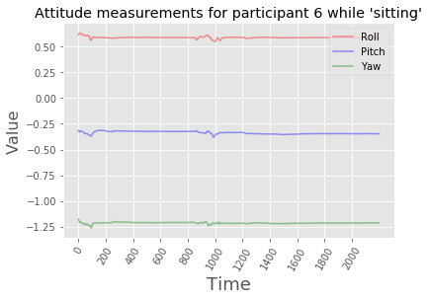
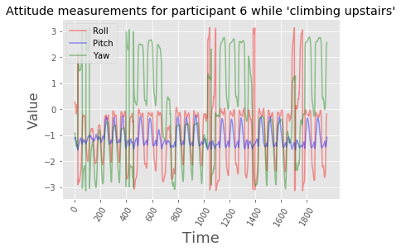
Initial analysis
Analyze few sensors measurements, for specific participant, performing two different actions
Can see the range of the attitude values and also the variance over time

Slide 7
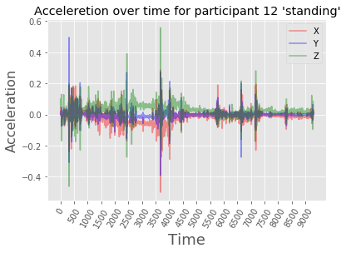
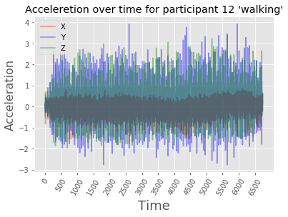
Initial analysis
This time using the Acceleration measurements
Again, change in values range over time, and greater variance over time

